Slide 1


<Name>
<Date>

Slide 2

Outline
Executive Summary
Introduction
Methodology
Results
Conclusion
Appendix

Slide 3
Executive Summary
Summary of methodologies
Data Collection through API
Data Collection with Web Scraping
Data Wrangling
Exploratory Data Analysis with SQL
Exploratory Data Analysis with Data Visualization
Interactive Visual Analytics with Folium
Machine Learning Prediction
Summary of all results
Exploratory Data Analysis result
Interactive analytics demo in screenshots
Predictive Analytics result

Slide 4
Introduction
Project background and context
SpaceX promotes Falcon 9 rocket launches at $62 million, a considerable saving compared to other providers, mainly attributed to the reusable first stage. The project's objective is to analyze SpaceX launch data and build a model to predict the successful landing of the first stage, allowing for cost estimation and competitive bidding in rocket launch endeavors.
Problems you want to find answers
Which factors determine if the rocket will land successfully?
How much influence does each variable have on rocket landing success?
How to improve the success rate of rocket landing?

Slide 5

Section 1

Slide 6
Methodology
Executive Summary
Data collection methodology:
Historical Data Compilation: Collect historical data of Falcon 9 launches, including both successful and unsuccessful landing attempts. This data from SpaceX API and web scraping from Wikipedia.
Perform data wrangling
Data Cleaning and Preprocessing: Clean the collected data by addressing missing values, outliers, and any inconsistencies. Preprocess the data to ensure it is in a format suitable for machine learning analysis.
Perform exploratory data analysis (EDA) using visualization and SQL
Perform interactive visual analytics using Folium and Plotly Dash
Perform predictive analysis using classification models
How to build, tune, evaluate classification models

Slide 7
Data Collection
Describe how data sets were collected.
First, Data collection was done using get request to the SpaceX API.
Second, decoded the response content as a Json using .json() function call and turn it into a pandas dataframe using .json_normalize().
Third, cleaned the data, checked for missing values and fill in missing values where necessary.

Slide 8
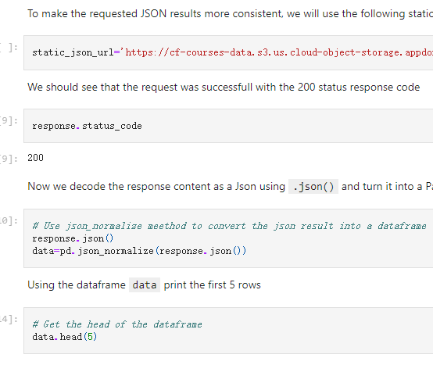
Data Collection – SpaceX API
Used the requests.get () function to access the spacex API to collect data
The link to the notebook is: https://github.com/haodata/Data-Science-Capstone-Project/blob/main/week1.1jupyter-labs-spacex-data-collection-api.ipynb
Place your flowchart of SpaceX API calls here

Slide 9
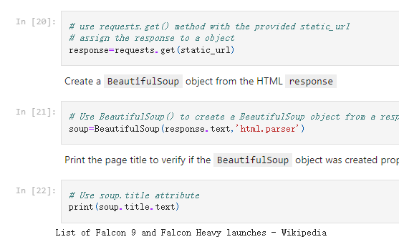
Data Collection - Scraping
Identify Target Websites
Choose a Web Scraping Tool: Beautifulsoup
Inspect Website Structure
Access Permissions: requests.get()
Parse HTML Content
The link to the notebook is :
https://github.com/haodata/Data-Science-Capstone-Project/blob/main/jupyter-labs-webscraping.ipynb
Place your flowchart of web scraping here

Slide 10
dtypes
dtypes
Data Wrangling
Describe how data were processed
Used isnull().sum() function to summarize all the null in data frame
Used type() function to identify data types.
calculated the number of launches at each site, the number and occurrence of each orbits by using .value_counts() function
Created a landing outcome label from Outcome column
The link is :
https://github.com/haodata/Data-Science-Capstone-Project/blob/main/labs-jupyter-spacex-Data%20wrangling.ipynb

Slide 11
EDA with Data Visualization
Summarize what charts were plotted and why you used those charts
Scatter plot, bar plot ,line plot were used for data visualization.
Because Scatter plots are useful for identifying relationships between two continuous variables and for detecting patterns or trends in data.
Bar plots are useful for comparing the sizes of different categories or groups.
Line plots commonly used to show trends over a continuous interval or time series data.
Add the GitHub URL of your completed EDA with data visualization notebook, as an external reference and peer-review purpose
https://github.com/haodata/Data-Science-Capstone-Project/blob/main/week2%20matplotlib%20jupyter-labs-eda-dataviz.ipynb.jupyterlite.ipynb

Slide 12
EDA with SQL
used magic command %sql that allows to write SQL queries directly.
Applied EDA with SQL to get insight from the data. for instance:
The names of unique launch sites in the space mission.
The total payload mass carried by boosters launched by NASA (CRS)
The average payload mass carried by booster version F9 v1.1
The total number of successful and failure mission outcomes
The failed landing outcomes in drone ship, their booster version and launch site names.
The link is :
https://github.com/haodata/Data-Science-Capstone-Project/blob/main/jupyter-labs-eda-sql-coursera_sqllite.ipynb

Slide 13
Build an Interactive Map with Folium
Marked all launch sites, and added map objects such as markers, circles, lines to mark the success or failure of launches for each site on the folium map.
Assigned the feature launch outcomes (failure or success) to class 0 and 1.i.e., 0 for failure, and 1 for success.
Used the color-labeled marker clusters, we identified which launch sites have relatively high success rate.
calculated the distances between a launch site to its proximities. for instance:
Are launch sites near railways, highways and coastlines.
Do launch sites keep certain distance away from cities.
The link is:
https://github.com/haodata/Data-Science-Capstone-Project/blob/main/week3%201lab_jupyter_launch_site_location.jupyterlite.ipynb

Slide 14
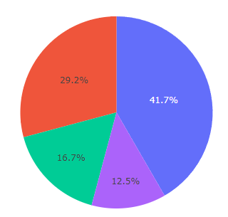
Build a Dashboard with Plotly Dash
Plotted pie charts showing the total launches by a certain sites
Plotted scatter graph showing the relationship with Outcome and Payload Mass (Kg) for the different booster version.
A callback function was added in the plot
The link is :
https://github.com/haodata/Data-Science-Capstone-Project/blob/main/week3%20spacex_dash_app.py

Slide 15
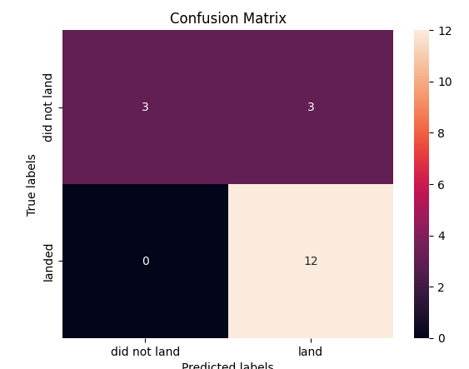
Predictive Analysis (Classification)
Loaded the data using numpy and pandas, transformed the data, split our data into training and testing.
Built different machine learning models and tune different hyperparameters using GridSearchCV.
used accuracy as the metric for our model, improved the model using feature engineering and algorithm tuning.
found the best performing classification model.
The link is:
https://github.com/haodata/Data-Science-Capstone-Project/blob/main/SpaceX_Machine_Learning_Prediction_Part_5.jupyterlite.ipynb

Slide 16
Results
Exploratory data analysis results
Interactive analytics demo in screenshots
Predictive analysis results

Slide 17

Section 2

Slide 18
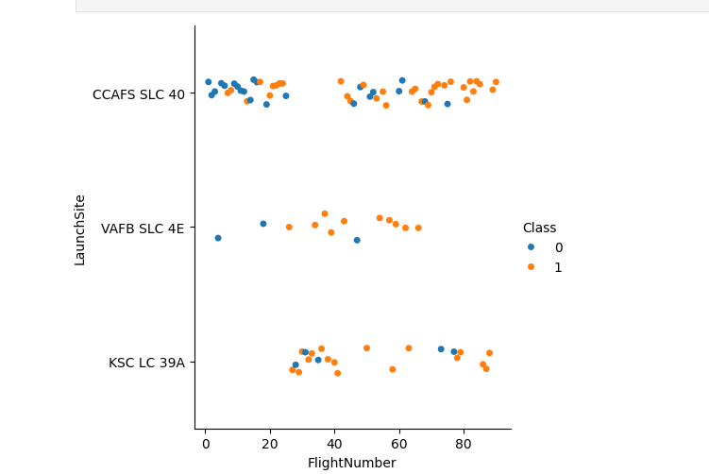
Flight Number vs. Launch Site
It can be seen from the figure that as the number of launches increases, the success rate also increases.

Slide 19
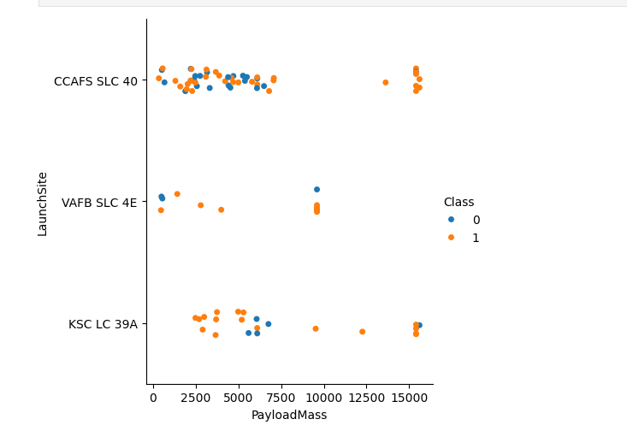
Payload vs. Launch Site
In launch site CCAFS SLC 40, the greater the payload mass, the greater the probability of successful rate.

Slide 20
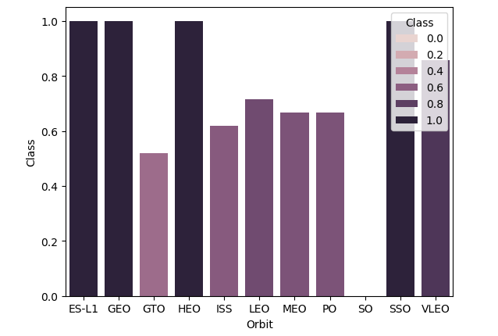
Success Rate vs. Orbit Type
From the plot, we can see that ES-L1, GEO, HEO, SSO, VLEO had the most success rate.

Slide 21
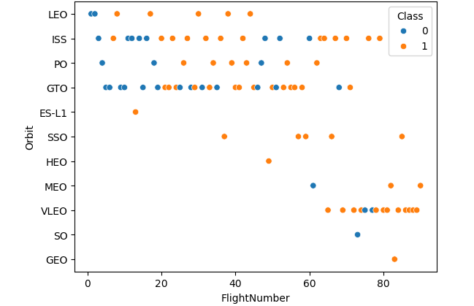
Flight Number vs. Orbit Type
In orbit LEO, as the number of launches increases, the success rate also increases. In orbit SSO, there is one hundred percent success rate.

Slide 22
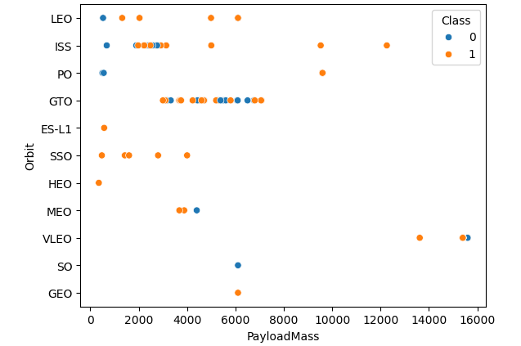
Payload vs. Orbit Type
We can observe that with heavy payloads, the successful landing are more for LEO and ISS orbits.

Slide 23
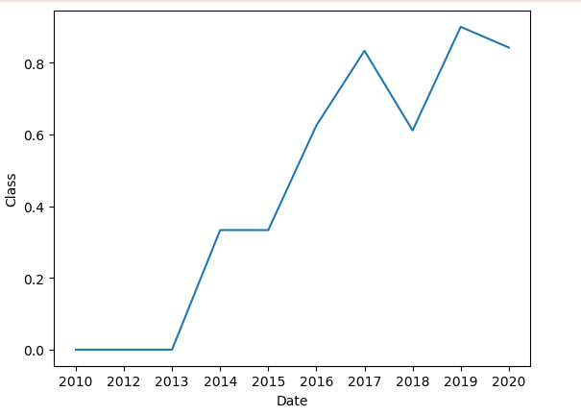
Launch Success Yearly Trend
From the plot, we can see that success rate since 2013 kept on increasing till 2020

Slide 24
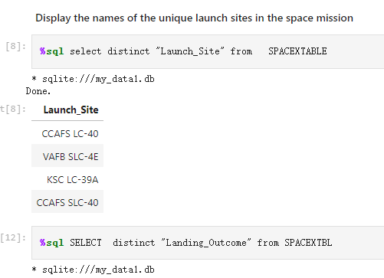
All Launch Site Names
Used distinct() function to query Launch_Site column

Slide 25
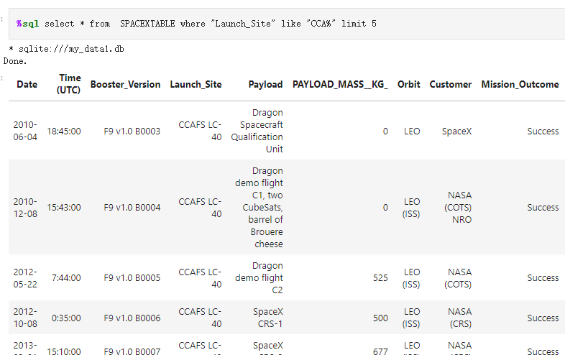
Launch Site Names Begin with 'CCA'
Find 5 records where launch sites begin with `CCA` by using limit ()method

Slide 26
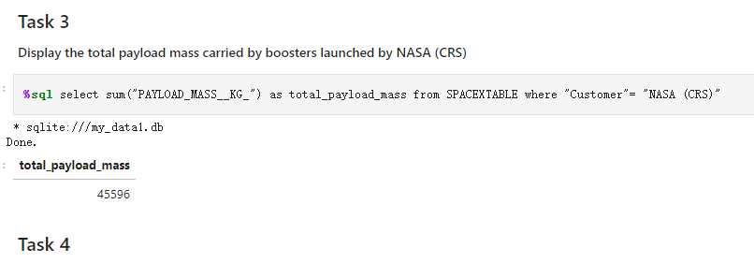
Total Payload Mass
Used the sum() method the total payload carried by boosters from NASA is 45596

Slide 27
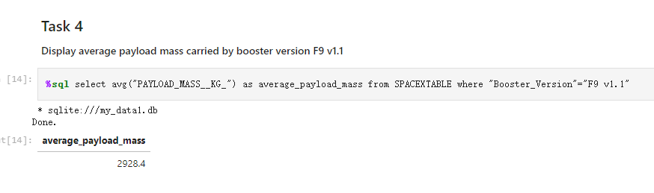
Average Payload Mass by F9 v1.1
By using avg() method the average payload mass carried by booster version F9 v1.1 is 2928.4

Slide 28
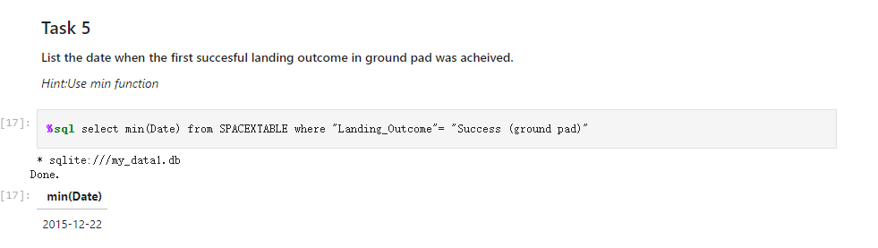
First Successful Ground Landing Date
By using min () method find that the dates of the first successful landing outcome on ground pad is 2015-12-22

Slide 29
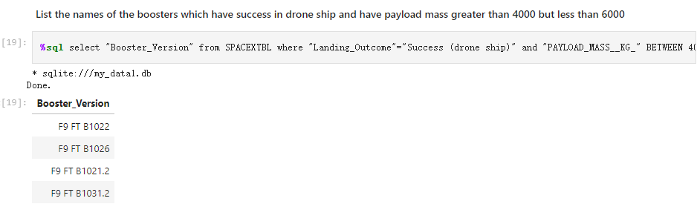
Successful Drone Ship Landing with Payload between 4000 and 6000
used the WHERE method to filter for boosters which have successfully landed on drone ship and applied the AND condition to determine successful landing with payload mass greater than 4000 but less than 6000

Slide 30
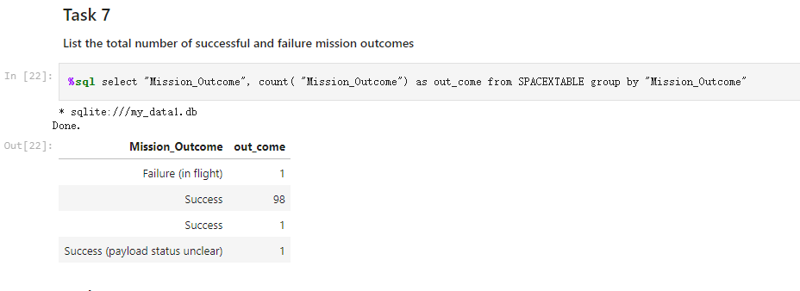
Total Number of Successful and Failure Mission Outcomes
By using groupby() function to calculate the total number of successful and failure mission outcomes

Slide 31
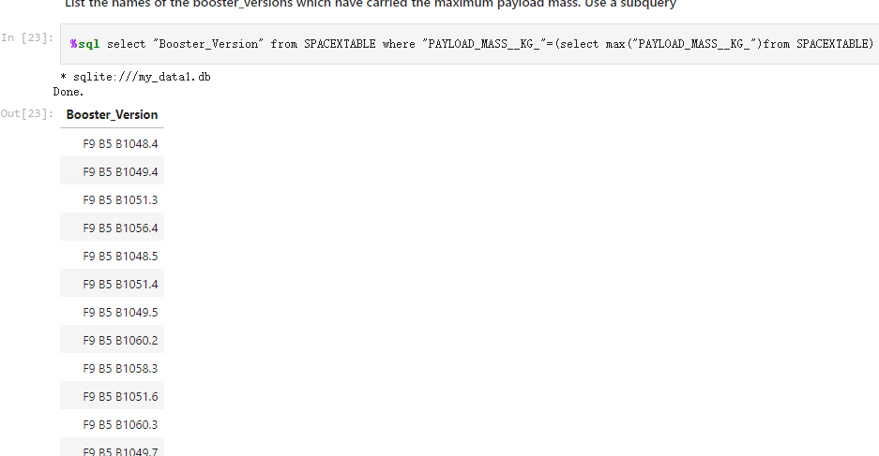
Boosters Carried Maximum Payload
Used subquery and max() functions to query the Boosters Carried Maximum Payload

Slide 32
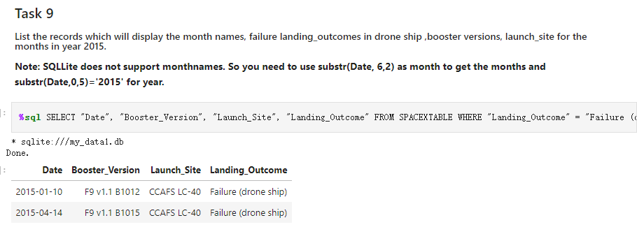
2015 Launch Records
Used a combinations of the where clause, ’like’ ,’and ‘, and’between’ conditions to filter for failed landing outcomes in drone ship, their booster versions, and launch site names for year 2015

Slide 33
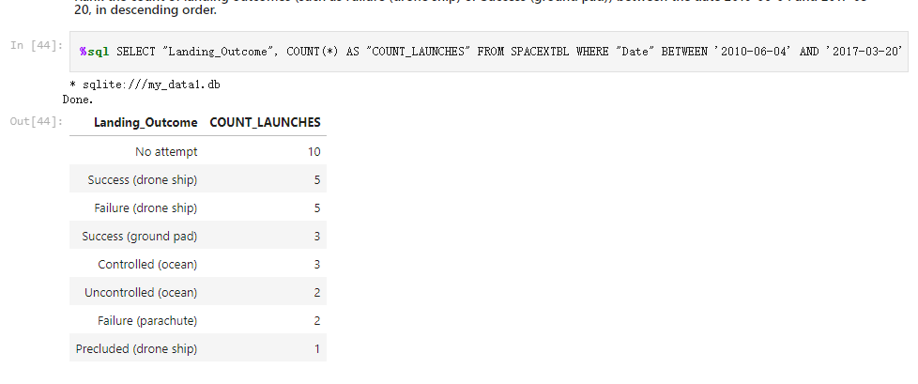
Rank Landing Outcomes Between 2010-06-04 and 2017-03-20
selected Landing outcomes and the COUNT of landing outcomes from the data and used the WHERE clause to filter for landing outcomes BETWEEN 2010-06-04 to 2010-03-20.
Applied the GROUP BY clause to group the landing outcomes and the ORDER BY clause to order the grouped landing outcome in descending order.

Slide 34

Section 3

Slide 35

Global Map

Slide 36

Florida Launch Sites Map

Slide 37

Distance Map

Slide 38

Section 4

Slide 39
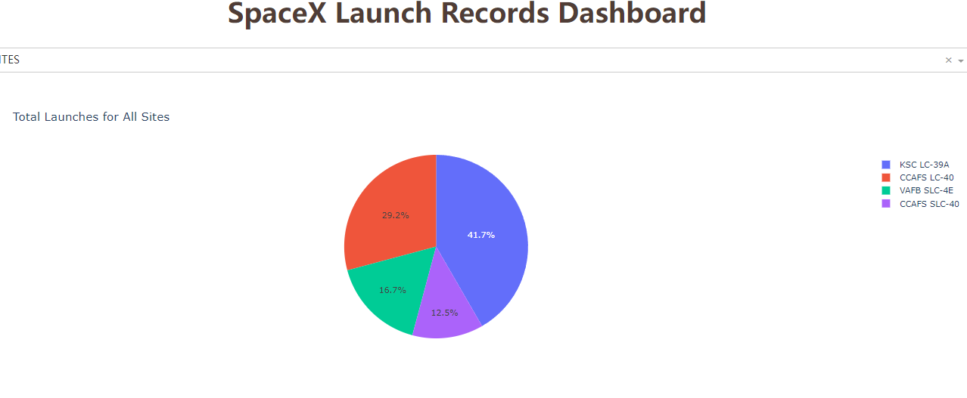
Launch Success Count For All Sites
KSC LC-39A has the highest successful launches

Slide 40
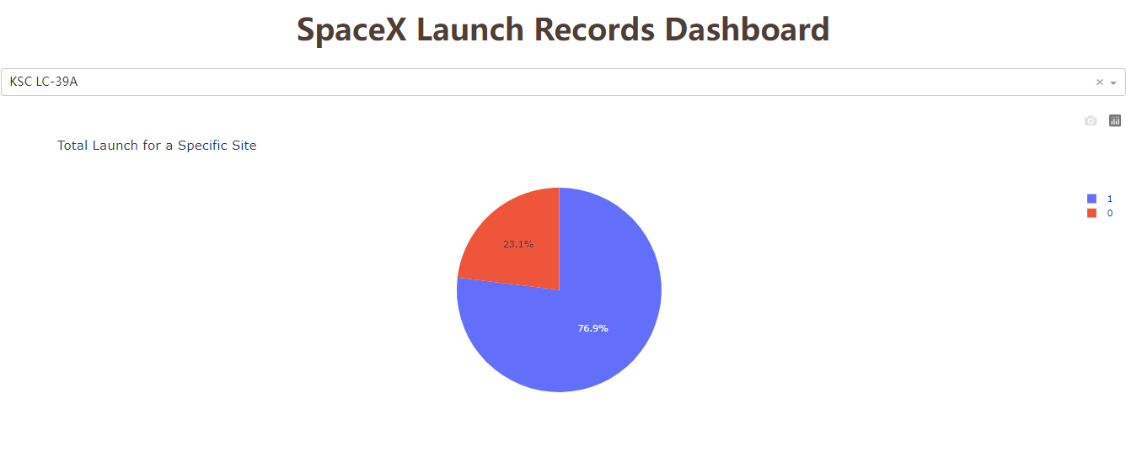
The Launch Site With Highest Launch Success Ratio
The successful rate is 76.9%

Slide 41

Payload vs. Launch Outcome scatter plot

Slide 42

Section 5

Slide 43
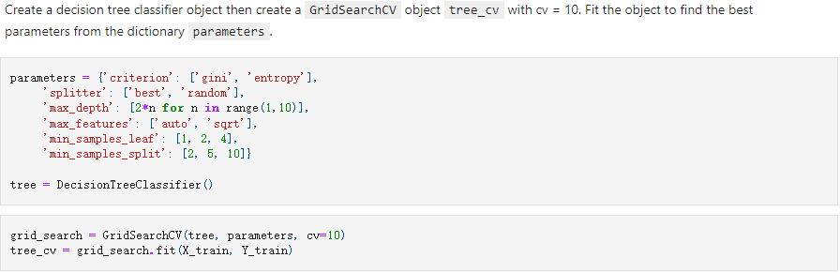
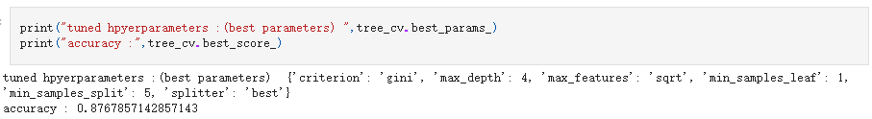
Classification Accuracy
The decision tree classifier is the model with the highest classification accuracy which is about 0.8768

Slide 44
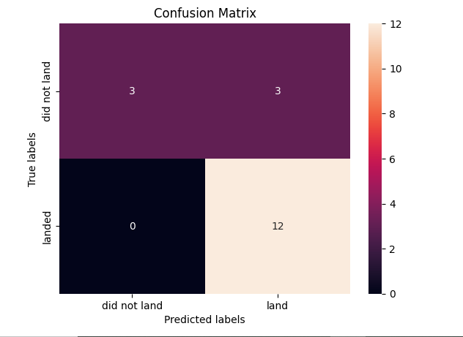
Confusion Matrix
The confusion matrix for the decision tree classifier shows that the classifier can distinguish between the different classes. The major problem is the false positives .i.e., unsuccessful landing marked as successful landing by the classifier.

Slide 45
Conclusions
The larger the flight amount at a launch site, the greater the success rate at a launch site.
The launch success rate started to increase sharply from 2013 to 2020.
Orbits ES-L1, GEO, HEO, SSO, and VLEO had the most success rate.
KSC LC-39A had the most successful launches of any sites.
The Decision tree classifier is the best machine-learning algorithm for this task.

Slide 46
Appendix
Include any relevant assets like Python code snippets, SQL queries, charts, Notebook outputs, or data sets that you may have created during this project

Slide 47


